Slide 1
PowerPoint template to accompany the My Family RSHE lesson pack for:
Primary aged children – version 2 SEND
We know that good teaching is tailored to meet the needs of the children or young people in each individual class. That’s why we’ve created this editable PowerPoint template – feel free to adapt it to suit your teaching context or to add your school or college slide template to the background.
Who are Stonewall?
This resource is produced by Stonewall, a UK-based charity that stands for the freedom, equity and potential of all lesbian, gay, bi, trans, queer, questioning and ace (LGBTQ+) people. At Stonewall, we imagine a world where LGBTQ+ people everywhere can live our lives to the full. Founded in London in 1989, we now work in each nation of the UK and have established partnerships across the globe. Over the last three decades, we have created transformative change in the lives of LGBTQ+ people in the UK, helping win equal rights around marriage, having children and inclusive education.
Our campaigns drive positive change for our communities, and our sustained change and empowerment programmes ensure that LGBTQ+ people can thrive throughout our lives. We make sure that the world hears and learns from our communities, and our work is grounded in evidence and expertise.
Stonewall is proud to provide information, support and guidance on LGBTQ+ inclusion; working towards a world where we’re all free to be. This does not constitute legal advice, and is not intended to be a substitute for legal counsel on any subject matter. To find out more about our work, visit us at www.stonewall.org.uk.
Registered Charity No 1101255 (England and Wales) and SC039681 (Scotland)
Notes:
Visit our website for the lesson plan to accompany this PowerPoint.

Slide 2
To take part in a sensory story AND To communicate about a picture of my family
To answer questions about a story AND To answer questions about my family
To talk about events in a story and link them to my own experiences AND To say how we should behave towards family members

Slide 3

Donovan’s big day
Notes:
As a class, read Donovan’s Big Day. Use the sensory props to support understanding and engagement.

Slide 4
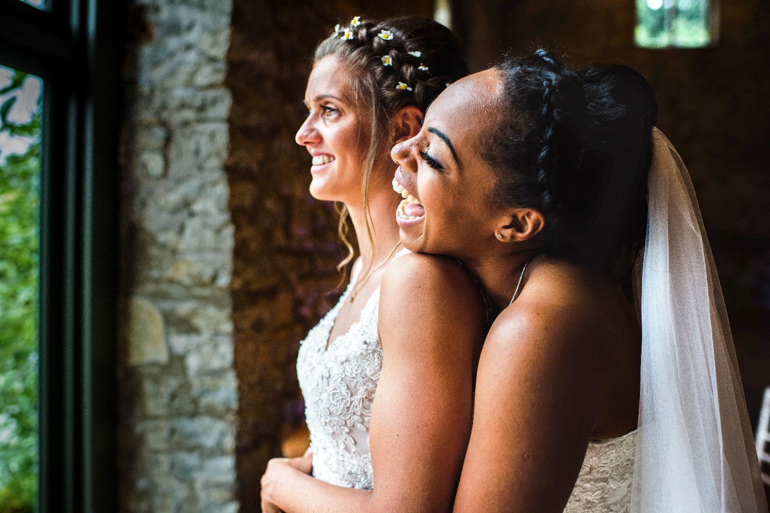
What was the special occasion?
Donovan’s mums got married.
Notes:
What was the special occasion in the story? Students to answer if they are able to, or match key symbols

Slide 5
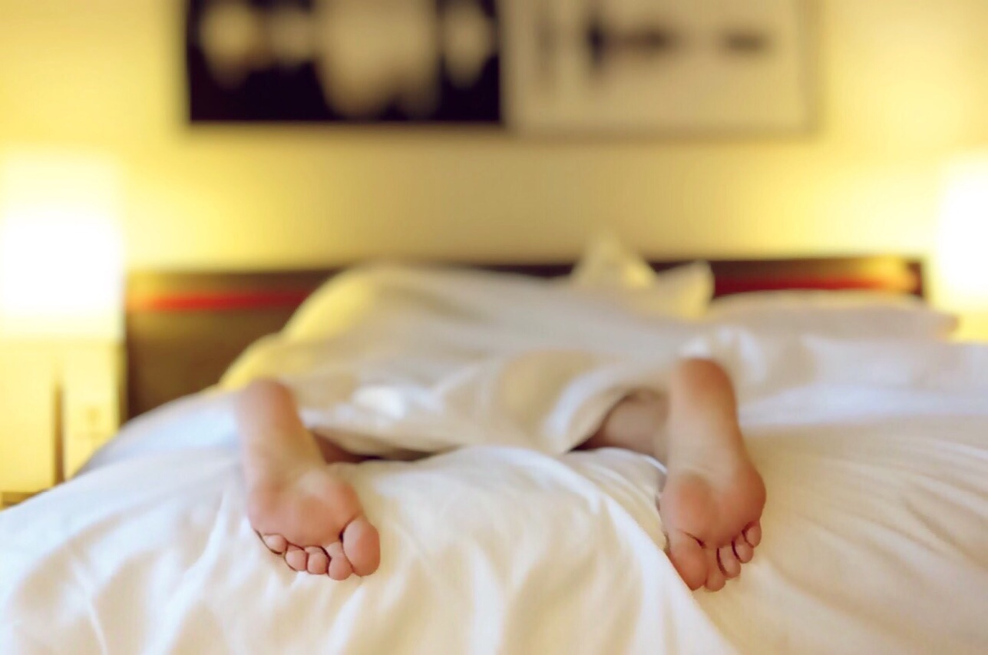
Who woke Donovan up?
Grandpa woke Donovan up.
Notes:
Who woke Donovan up? Students to answer if they are able to, or match key symbols

Slide 6

What did Donovan look
after?
The ring box.
Notes:
What did Donovan look after? Students to answer if they are able to, or match key symbols

Slide 7
What Donovan have to say?
“You may now kiss the brides!”
Notes:
What did Donovan have to say? Students to answer if they are able to, or match key symbols

Slide 8
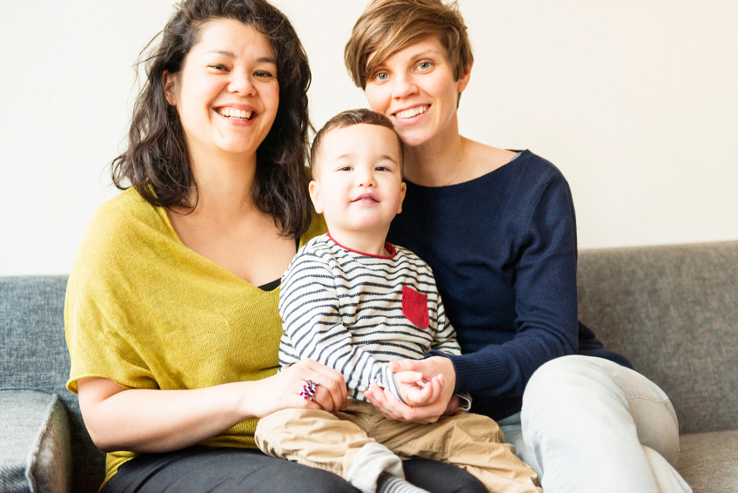
Who is in Donovan’s family?
Mum Mum Donovan
Notes:
Who is in Donovan’s family? Students to answer if they are able to, or match key symbols

Slide 9
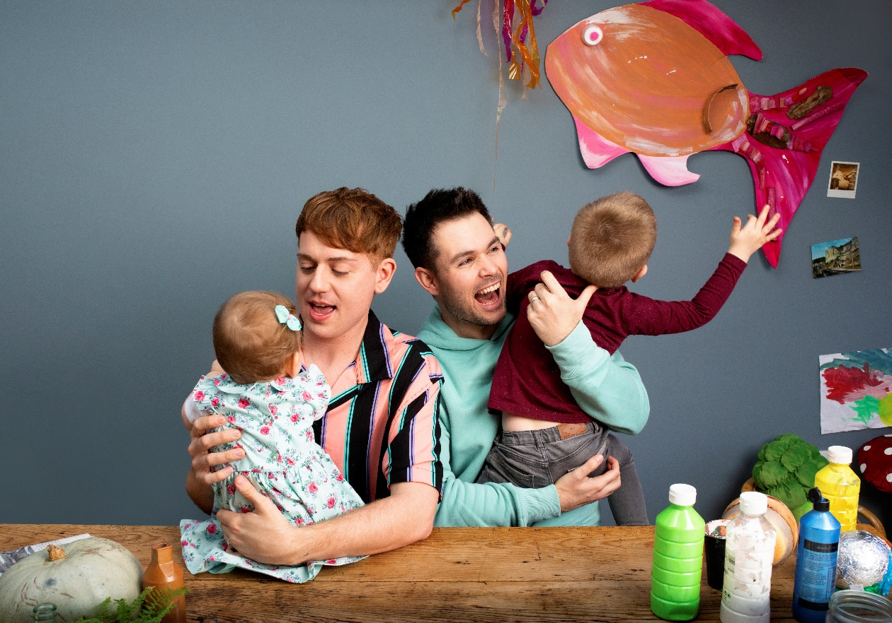
Who is in this family?
Dad Dad Sister Brother
Notes:
Look at the photos of different families. Who is in each?
Students to respond to the questions or match key symbols relating to the families.

Slide 10
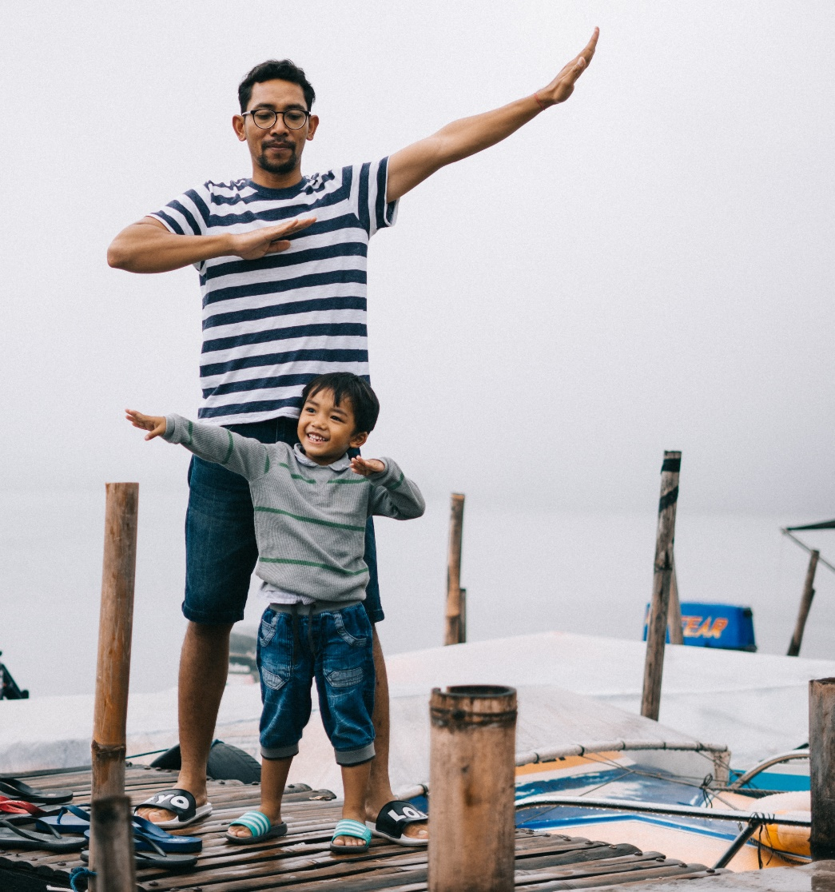
Who is in this family?
Dad Asif
Notes:
Look at the photos of different families. Who is in each?
Students to respond to the questions or match key symbols relating to the families.

Slide 11
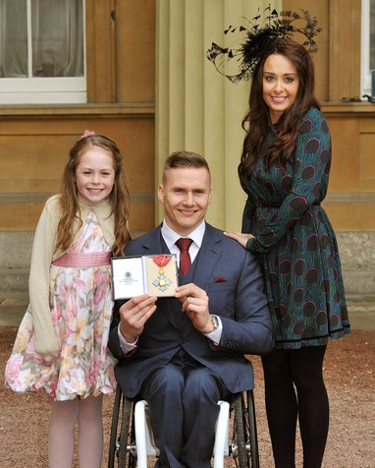
Who is in this family?
Mum Dad Ronie
Notes:
Look at the photos of different families. Who is in each?
Students to respond to the questions or match key symbols relating to the families.

Slide 12
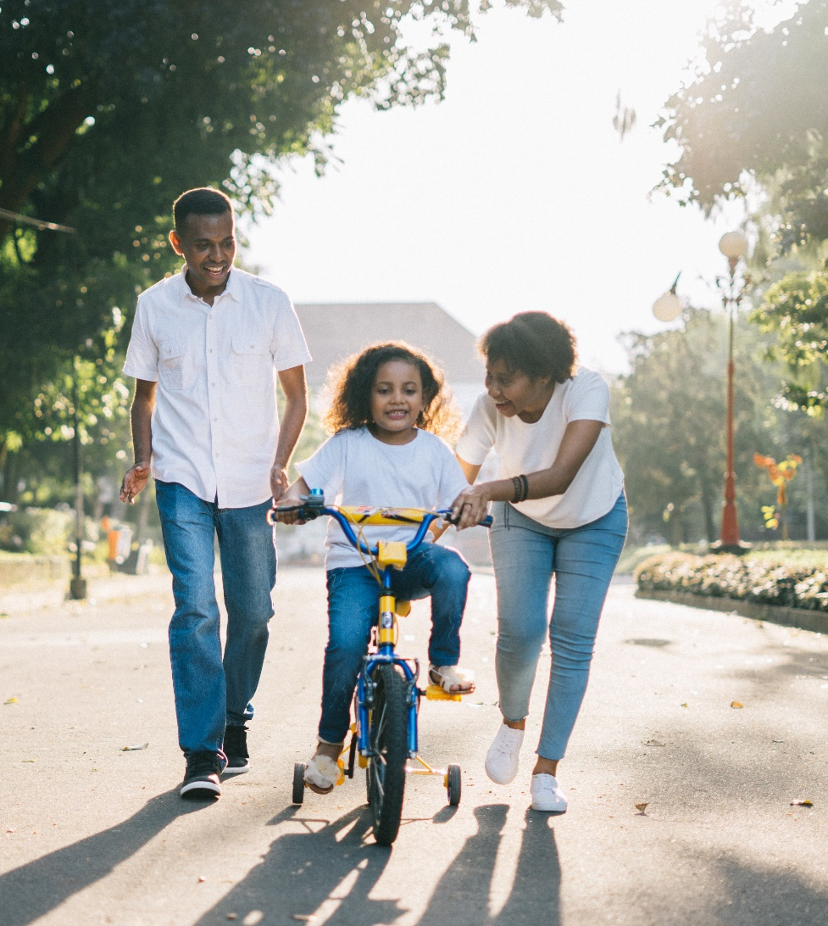
Who is in this family?
Foster Dad Foster Mum Hannah
Notes:
Look at the photos of different families. Who is in each?
Students to respond to the questions or match key symbols relating to the families.

Slide 13
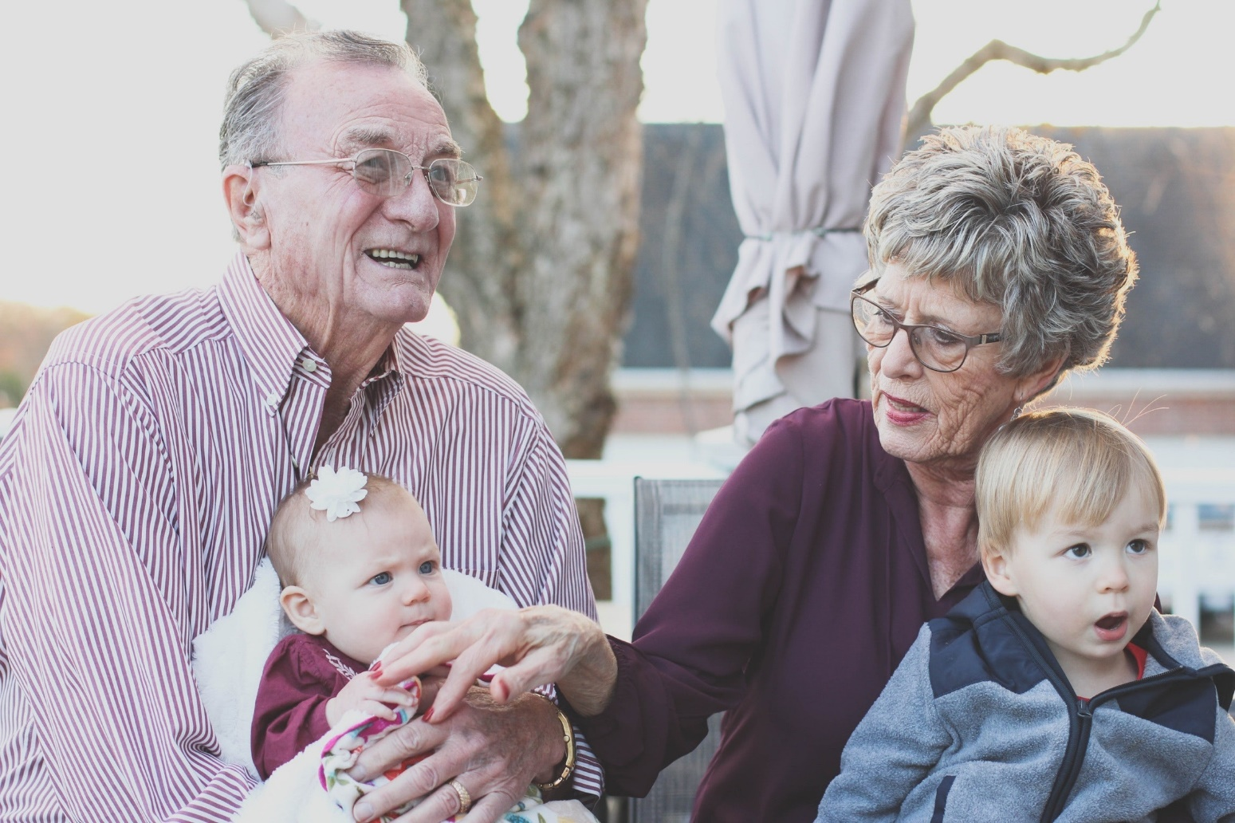
Who is in this family?
Grandma Grandpa Tess Alex
Notes:
Look at the photos of different families. Who is in each?
Students to respond to the questions or match key symbols relating to the families.

Slide 14
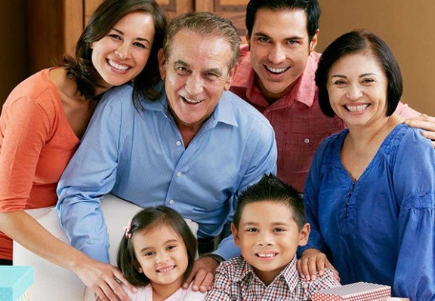
Who is in this family?
Mum Dad Priti
Grandma Grandpa Rom
Notes:
Look at the photos of different families. Who is in each?
Students to respond to the questions or match key symbols relating to the families.

Slide 15
Who is in your family?
Notes:
Ask: Who is in your family? Students share who is in their family.

Slide 16

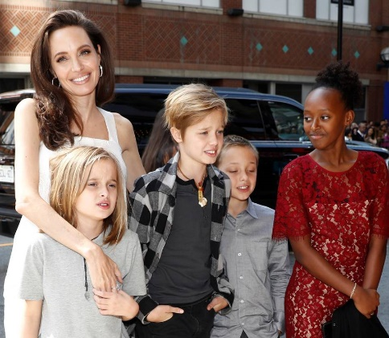
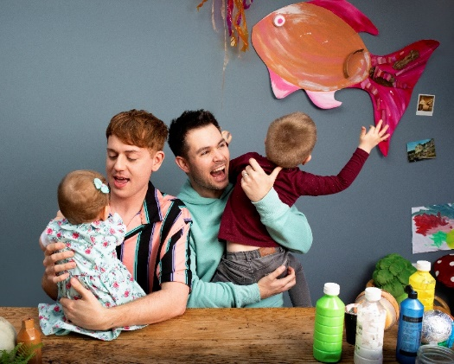
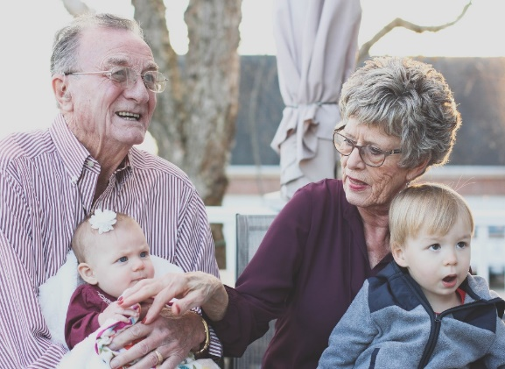
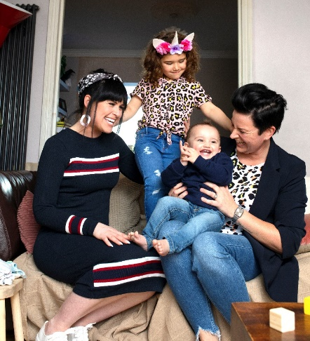


How are these families similar to your family?
Notes:
Ask students to discuss how each family is similar to and different from their family.

Slide 17
How are these families different from your family?
Notes:
Ask students to discuss how each family is similar to and different from their family.

Slide 18


Family portrait
Draw your family.
Write about your family.
Write words to say how we should behave
towards our family.
Notes:
Students create a family portrait and then label it – see the lesson plan for differentiated activity.

Slide 19
Who is in your family?
How are our families different?
How are our families similar?
Notes:
Share the family portraits, talk about who is in each person’s family. How are our families different, how are they similar?

Slide 20
How should we behave towards
our family?
Love
Gentle
Kind words
Notes:
Talk about the importance of being loving and kind to our families.

