Slide 1
PowerPoint template to accompany the Who Am I? lesson pack for:
Key Stage 3 students
We know that good teaching is tailored to meet the needs of the children or young people in each individual class. That’s why we’ve created this editable PowerPoint template – feel free to adapt it to suit your teaching context or to add your school or college slide template to the background.
Who are Stonewall?
This resource is produced by Stonewall, a UK-based charity that stands for the freedom, equity and potential of all lesbian, gay, bi, trans, queer, questioning and ace (LGBTQ+) people. At Stonewall, we imagine a world where LGBTQ+ people everywhere can live our lives to the full. Founded in London in 1989, we now work in each nation of the UK and have established partnerships across the globe. Over the last three decades, we have created transformative change in the lives of LGBTQ+ people in the UK, helping win equal rights around marriage, having children and inclusive education.
Our campaigns drive positive change for our communities, and our sustained change and empowerment programmes ensure that LGBTQ+ people can thrive throughout our lives. We make sure that the world hears and learns from our communities, and our work is grounded in evidence and expertise.
Stonewall is proud to provide information, support and guidance on LGBTQ+ inclusion; working towards a world where we’re all free to be. This does not constitute legal advice, and is not intended to be a substitute for legal counsel on any subject matter. To find out more about our work, visit us at www.stonewall.org.uk.
Registered Charity No 1101255 (England and Wales) and SC039681 (Scotland)
Notes:
Visit our website for the lesson plan to accompany this PowerPoint.

Slide 2
Title page
School & College Role Models
My Faith
Notes:
This PowerPoint is for use with post-16 learners and can be used with the Stonewall x Burberry School & College Role Models Who Am I? lesson pack, which can be downloaded from our website.

Slide 3
Learning objective
To use source materials to gain a deeper understanding of LGBTQ+ people’s experiences in relation to religion

Slide 4

Class agreement
How are we going to work together in class?
How can we make sure everyone feels safe, welcome and included?
Notes:
Explain to students that you're going to be discussing faith and identity during the session.
As a class, agree some ground rules for the session. For example, treating others (including the person on the video) with respect, expressing opinions in a respectful manner, taking part constructively in conversations, etc.

Slide 5
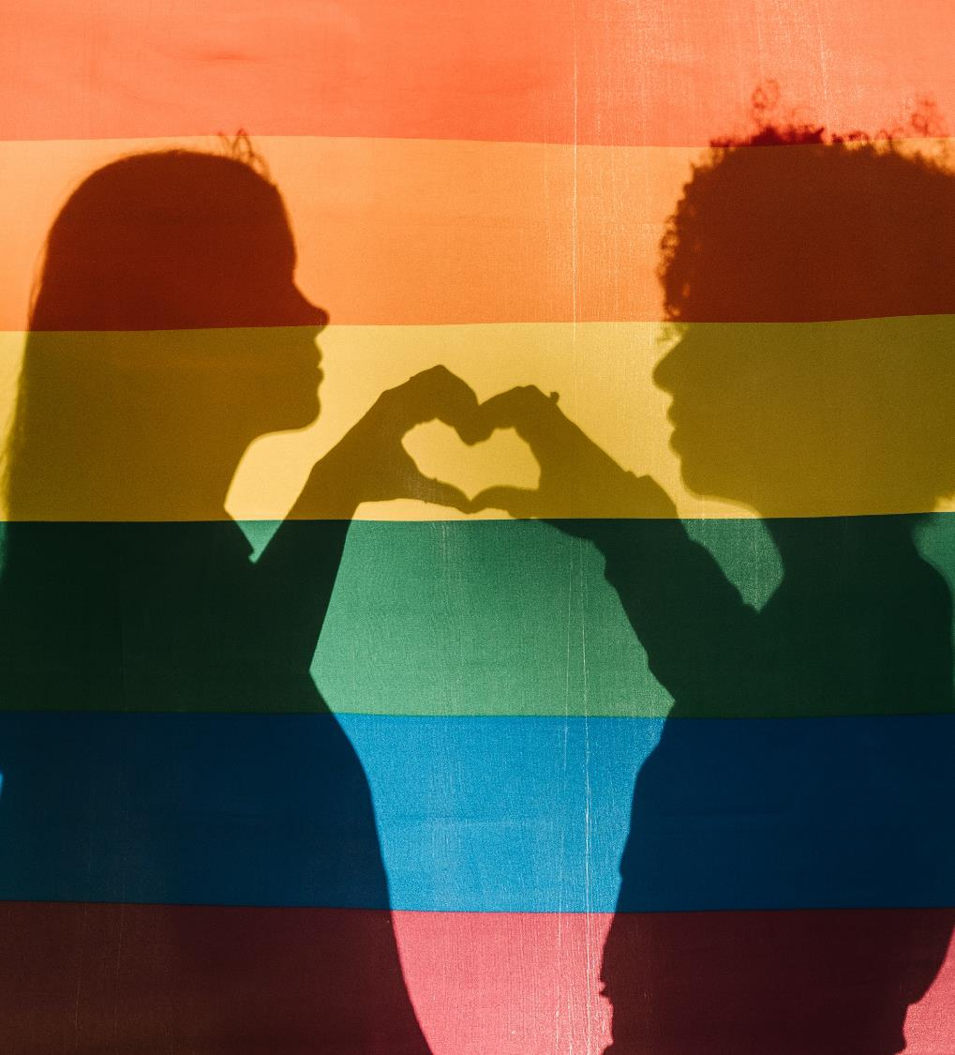
How might an LGBTQ+ person of faith experience the world differently to a non-religious LGBTQ+ person?
Notes:
Ask students: How might an LGBTQ+ person of faith experience the world differently to a non-religious LGBTQ+ person? Are those differences positive or negative?
In groups of 3, challenge students discuss their instinctual answer to the question. Encourage them to explain why they have answered in that way.

Slide 6
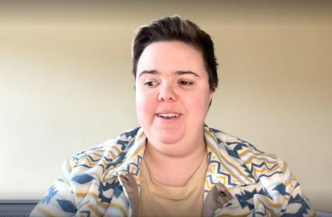
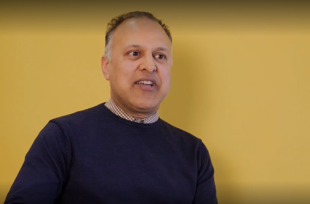
School & College Role Model Video
What are the experiences of LGBTQ+ people of faith?
Notes:
Explain that you're going to use a range of source materials to help them form an evidence based answer to the question.
Watch one or more of Stonewall's School & College Role Model videos. Miki, Khakan and Philip are all people of faith, so you might wish to choose them.

Slide 7

Written sources
What are the experiences of LGBTQ+ people of faith?
Is there a difference for LGBTQ+ people who aren’t religious?
Are there organisations supporting LGBTQ+ people of faith?
Notes:
Students to use written materials to find out about the lives of LGBTQ+ people of faith. They should work in groups of 3 to share the research load and share their findings with each other.
They could use:
Stonewall's LGBT in Britain: Home and Communities report
Websites from LGBTQ+ specific faith organisations such as LGBTQI Imaam, Hidayah LGBT, Sarbat Sikhs, Keshet UK, Quest, Open Table Network, House of Rainbow
Notes and resources from previous lessons

Slide 8
How might an LGBTQ+ person of faith experience the world differently to a non-religious LGBTQ+ person?
Notes:
Based on the research they had done as a group, students should discuss the question: How might an LGBTQ+ person of faith experience the world differently to a non-religious LGBTQ+ person? Are those differences positive or negative?
Did they change their opinion or answer based on the evidence? If so, what was it that changed their opinion? If not, why do they think their opinion didn't change?

Slide 9
Recap
To use source materials to gain a deeper understanding of LGBTQ+ people’s experiences in relation to religion
Did the lesson challenge or reinforce your beliefs?
Notes:
Ask students: To what extent did the lesson challenge your thoughts on this topic? To what extent did it reinforce them?
They could share their feedback by moving to one side of the room or the other, by a show of hands, or by writing the letter C (for challenge) or R (for reinforce) on a slip of paper and placing it in a container as they leave the room.

