Slide 1
PowerPoint template to accompany the Who Am I? lesson pack for:
Key Stage 3 students
We know that good teaching is tailored to meet the needs of the children or young people in each individual class. That’s why we’ve created this editable PowerPoint template – feel free to adapt it to suit your teaching context or to add your school or college slide template to the background.
Who are Stonewall?
This resource is produced by Stonewall, a UK-based charity that stands for the freedom, equity and potential of all lesbian, gay, bi, trans, queer, questioning and ace (LGBTQ+) people. At Stonewall, we imagine a world where LGBTQ+ people everywhere can live our lives to the full. Founded in London in 1989, we now work in each nation of the UK and have established partnerships across the globe. Over the last three decades, we have created transformative change in the lives of LGBTQ+ people in the UK, helping win equal rights around marriage, having children and inclusive education.
Our campaigns drive positive change for our communities, and our sustained change and empowerment programmes ensure that LGBTQ+ people can thrive throughout our lives. We make sure that the world hears and learns from our communities, and our work is grounded in evidence and expertise.
Stonewall is proud to provide information, support and guidance on LGBTQ+ inclusion; working towards a world where we’re all free to be. This does not constitute legal advice, and is not intended to be a substitute for legal counsel on any subject matter. To find out more about our work, visit us at www.stonewall.org.uk.
Registered Charity No 1101255 (England and Wales) and SC039681 (Scotland)
Notes:
Visit our website for the lesson plan to accompany this PowerPoint.

Slide 2
Title page
School & College Role Models
My Faith
Notes:
This PowerPoint is for use with Key Stage 3 (Scottish S1 to S3) learners and can be used with the Stonewall x Burberry School & College Role Models Who Am I? lesson pack, which can be downloaded from our website.

Slide 3
Learning objective
To reflect on my own beliefs around faith and religion

Slide 4
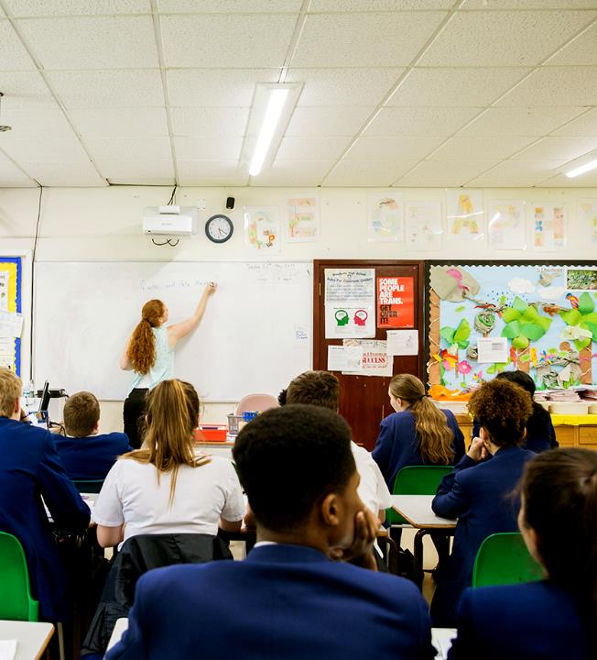
Class agreement
How are we going to work together in class?
How can we make sure everyone feels safe, welcome and included?
Notes:
Explain to students that you're going to be discussing faith and identity during the session. As a class, agree some ground rules for the session. For example, treating others (including the person on the video) with respect, expressing opinions in a respectful manner, taking part constructively in conversations, etc.

Slide 5
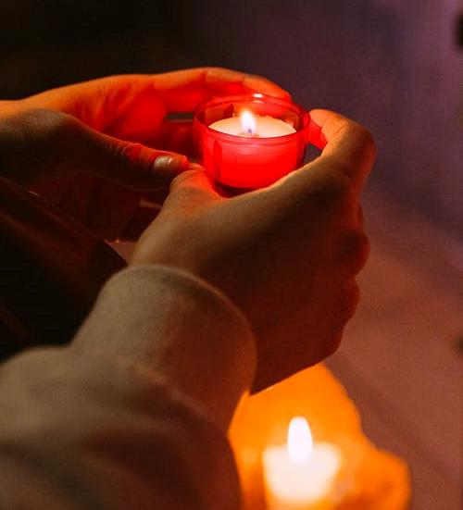
What does it mean to you?
Religion
Faith
Notes:
Ask students: When you hear the words 'religion' or 'faith', what do you think?
In groups of 3, challenge students to write as many individual words or short phrases as they can to express their thoughts. They should save what they have written, as they will return to it at the end of the session.

Slide 6
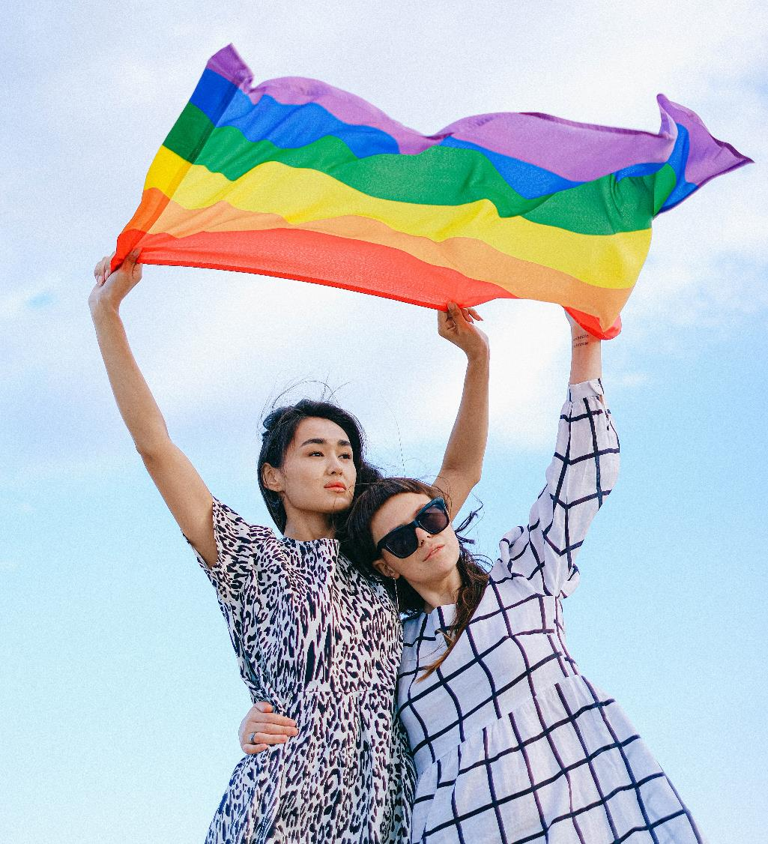
What does it mean to you?
LGBTQ+
Notes:
Ask students: What do you think when you hear the acronym 'LGBTQ+'?
In groups of 3, challenge students to write as many individual words or short phrases as they can to express their thoughts. They should save what they have written, as they will return to it at the end of the session.

Slide 7
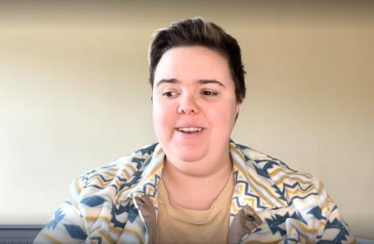
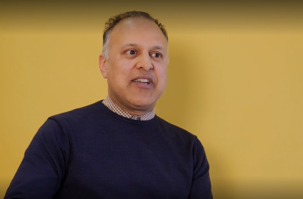
School Role Model Video
Watch and listen
Write a social media style caption for the video
Notes:
Watch one or more of Stonewall's School & College Role Model videos. Miki, Khakan and Philip are all people of faith, so you might wish to choose them.
Watch one or more of Stonewall's School & College Role Model videos. Miki, Khakan and Philip are all people of faith, so you might wish to choose them.
Students should write a social media style caption for one of the videos.

Slide 8

What do you think now?
Religion, faith, LGBTQ+
As a group, agree on:
Words to cross out
Words to underline
Words to add
Notes:
In their groups of 3, ask students to look back at the words they had written in relation to the words 'faith', 'religion' and 'LGBTQ+'.
They should discuss and come to a group decision on:
Words to cross out - because something about the video(s) changed their mind.
Words to underline - because something about the video(s) confirmed or reinforced what they already believed.
Words to add - either because something about the video(s) changed their mind, or because something about the video(s) reminded them of something else to write.
Ask students to share their thoughts on the process of coming to a consensus. What were the challenges? Discuss that every individual has their own beliefs and there are some things that we'll never get everyone to agree on. What matters, though, is how we treat people - kindly and with respect.

Slide 9
Recap
To reflect on my own beliefs around faith and religion
Did the lesson challenge or reinforce your beliefs?
Notes:
Ask students: To what extent did the lesson challenge your thoughts on this topic? To what extent did it reinforce them?
They could share their feedback by moving to one side of the room or the other, by a show of hands, or by writing the letter C (for challenge) or R (for reinforce) on a slip of paper and placing it in a container as they leave the room.

