Slide 1
PowerPoint template to accompany the Black History Month 2019 lesson pack for:
Learners with SEND/ASN/ALN – version 1
We know that good teaching is tailored to meet the needs of the children or young people in each individual class. That’s why we’ve created this editable PowerPoint template – feel free to adapt it to suit your teaching context or to add your school or college slide template to the background.
Who are Stonewall?
This resource is produced by Stonewall, a UK-based charity that stands for the freedom, equity and potential of all lesbian, gay, bi, trans, queer, questioning and ace (LGBTQ+) people. At Stonewall, we imagine a world where LGBTQ+ people everywhere can live our lives to the full. Founded in London in 1989, we now work in each nation of the UK and have established partnerships across the globe. Over the last three decades, we have created transformative change in the lives of LGBTQ+ people in the UK, helping win equal rights around marriage, having children and inclusive education.
Our campaigns drive positive change for our communities, and our sustained change and empowerment programmes ensure that LGBTQ+ people can thrive throughout our lives. We make sure that the world hears and learns from our communities, and our work is grounded in evidence and expertise.
Stonewall is proud to provide information, support and guidance on LGBTQ+ inclusion; working towards a world where we’re all free to be. This does not constitute legal advice, and is not intended to be a substitute for legal counsel on any subject matter. To find out more about our work, visit us at www.stonewall.org.uk.
Registered Charity No 1101255 (England and Wales) and SC039681 (Scotland)
Notes:
Visit our website for the lesson plan to accompany this PowerPoint.

Slide 2
To take part in activities relating to fairness
OR
To understand the words ‘fair’ and ‘not fair’/‘unfair’
OR
To identify how to treat people fairly
OR
To explain why we should treat people fairly

Slide 3
Fair
Notes:
As a class or in groups, play a short turn taking game such as Pop up Pirate. Ask a student to share out the swords so that everyone has the same number – use it as an opportunity to talk about fairness.
Students take turns to play the game. When taking turns, use it as an opportunity to discuss that taking turns in a game means that we are being fair.

Slide 4
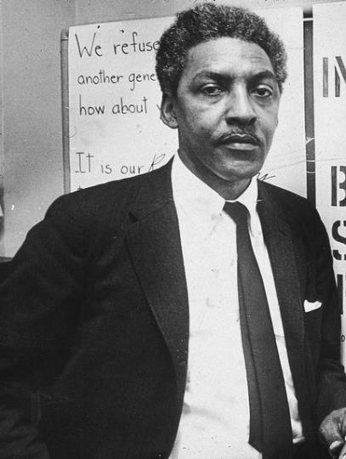
Bayard Rustin
Notes:
Share out the Bayard Rustin jigsaw pieces as a class or in groups. Students each take a turn to add a piece to the jigsaw until it is complete.

Slide 5
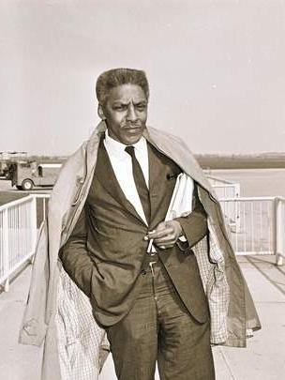
Bayard Rustin is a famous person from the past.
Notes:
Look at the picture of Bayard Rustin on the whiteboard, explain that Bayard Rustin was one of a group of black people from history who spoke about being treated unfairly because of the colour of their skin.

Slide 6
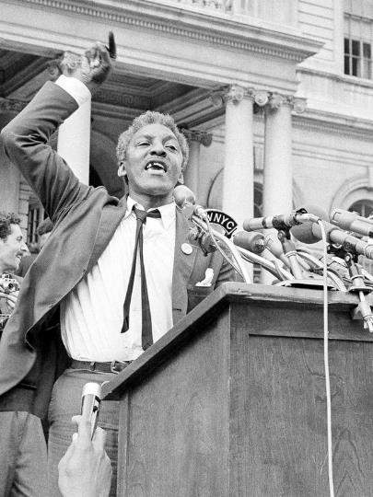
Bayard made speeches about black people being treated unfairly.
Notes:
Look at the picture of Bayard Rustin on the whiteboard, explain that Bayard Rustin was one of a group of black people from history who spoke about being treated unfairly because of the colour of their skin.

Slide 7
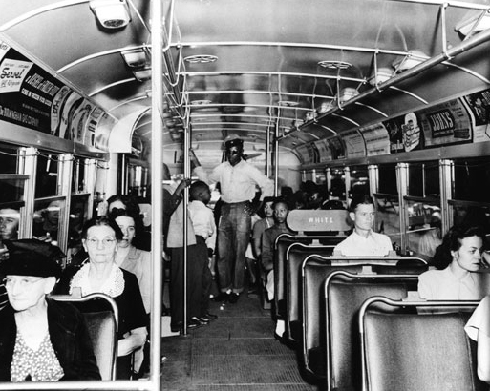
Fair or unfair?
Notes:
Black people were expected to give their seat on the bus to white people
For each scenario, ask students to:
Match the symbol for unfair
Identify if it was fair or unfair
Identify if it was fair or unfair and explain their answers.

Slide 8
Fair or unfair?
Unfair
Notes:
For each scenario, ask students to:
Match the symbol for unfair
Identify if it was fair or unfair
Identify if it was fair or unfair and explain their answers.

Slide 9
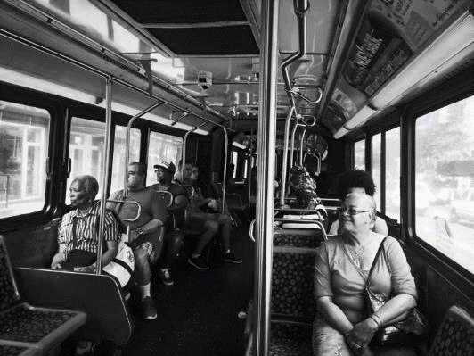
Fair or unfair?
Notes:
Rosa Parks said that black people and white people should all be able to have a seat on the bus.
For each scenario, ask students to:
Match the symbol for unfair
Identify if it was fair or unfair
Identify if it was fair or unfair and explain their answers.

Slide 10
Fair or unfair?
Fair
Notes:
For each scenario, ask students to:
Match the symbol for unfair
Identify if it was fair or unfair
Identify if it was fair or unfair and explain their answers.

Slide 11
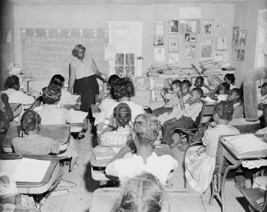
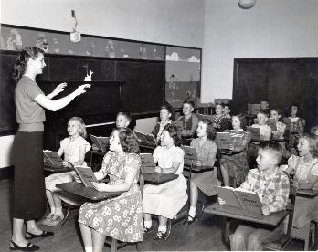
Fair or unfair?
Notes:
Black children had to go to different schools to white children. The white children’s schools were better and had more money.
For each scenario, ask students to:
Match the symbol for unfair
Identify if it was fair or unfair
Identify if it was fair or unfair and explain their answers.

Slide 12
Fair or unfair?
Unfair
Notes:
For each scenario, ask students to:
Match the symbol for unfair
Identify if it was fair or unfair
Identify if it was fair or unfair and explain their answers.

Slide 13
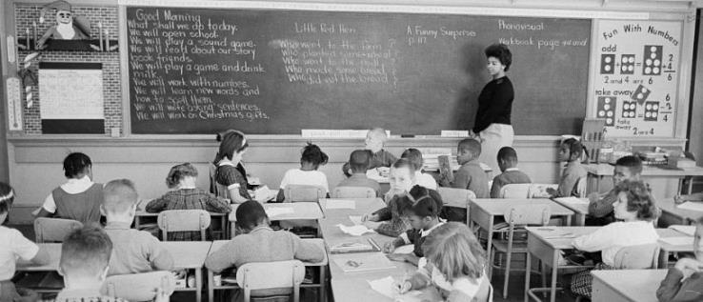
Fair or unfair?
Notes:
Martin Luther King Junior said that black children should be able to go to the same schools as white children.
For each scenario, ask students to:
Match the symbol for unfair
Identify if it was fair or unfair
Identify if it was fair or unfair and explain their answers.

Slide 14
Fair or unfair?
Fair
Notes:
For each scenario, ask students to:
Match the symbol for unfair
Identify if it was fair or unfair
Identify if it was fair or unfair and explain their answers.

Slide 15
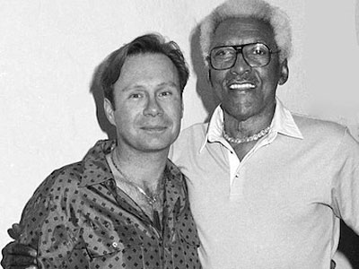
Fair or unfair?
X
Notes:
Gay men were sent to prison for having a boyfriend.
For each scenario, ask students to:
Match the symbol for unfair
Identify if it was fair or unfair
Identify if it was fair or unfair and explain their answers.

Slide 16
Fair or unfair?
X
Unfair
Notes:
Gay men were sent to prison for having a boyfriend.
For each scenario, ask students to:
Match the symbol for unfair
Identify if it was fair or unfair
Identify if it was fair or unfair and explain their answers.

Slide 17
Fair or unfair?
Notes:
Bayard Rustin was gay and wanted to be treated with kindness.
For each scenario, ask students to:
Match the symbol for unfair
Identify if it was fair or unfair
Identify if it was fair or unfair and explain their answers.

Slide 18
Fair or unfair?
Fair
Notes:
Bayard Rustin was gay and wanted to be treated with kindness.
For each scenario, ask students to:
Match the symbol for unfair
Identify if it was fair or unfair
Identify if it was fair or unfair and explain their answers.

Slide 19

Look at the pictures.
Which things are fair?
Which things are unfair?
Sort the pictures.
Notes:
Students complete the fair or unfair worksheet.
Choose the most suitable version of the worksheet for your students:
Match the ‘not fair’ photos into the box which says ‘not fair’. Match the ‘fair’ photos into the box which says ‘fair’.
Stick the photos into ‘fair’ and ‘not fair’ boxes.
Draw an example of something that is ‘not fair’ in the ‘not fair box’, draw an example of something that is ‘fair’ in the ‘fair box’.
Write examples of things that are unfair in the ‘unfair’ column. Write examples of things that are fair in the ‘fair’ column.

Slide 20
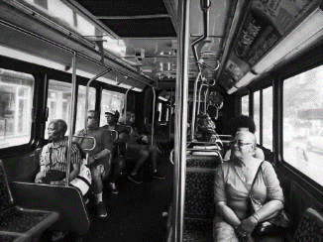
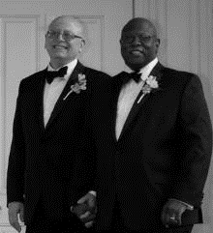

Fair
Notes:
Go through the pictures on the board, identify which was fair or unfair. Did we get it right on our worksheets?

Slide 21

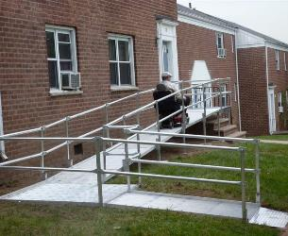
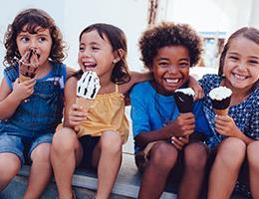
Fair
Notes:
Go through the pictures on the board, identify which was fair or unfair. Did we get it right on our worksheets?

Slide 22
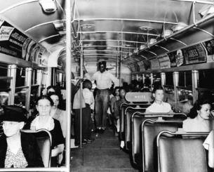


Unfair
X
Notes:
Go through the pictures on the board, identify which was fair or unfair. Did we get it right on our worksheets?

Slide 23
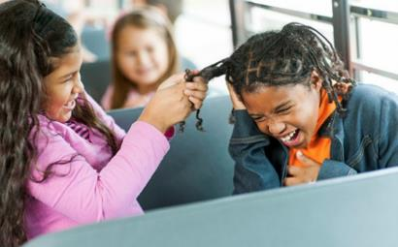
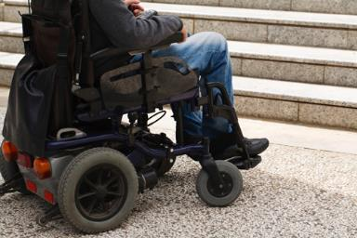

Unfair
Notes:
Go through the pictures on the board, identify which was fair or unfair. Did we get it right on our worksheets?

