Slide 1
PowerPoint template to accompany the Black History Month 2020 lesson pack for:
Learners with SEND/ALN/ASN – version 1
We know that good teaching is tailored to meet the needs of the children or young people in each individual class. That’s why we’ve created this editable PowerPoint template – feel free to adapt it to suit your teaching context or to add your school or college slide template to the background.
Who are Stonewall?
This resource is produced by Stonewall, a UK-based charity that stands for the freedom, equity and potential of all lesbian, gay, bi, trans, queer, questioning and ace (LGBTQ+) people. At Stonewall, we imagine a world where LGBTQ+ people everywhere can live our lives to the full. Founded in London in 1989, we now work in each nation of the UK and have established partnerships across the globe. Over the last three decades, we have created transformative change in the lives of LGBTQ+ people in the UK, helping win equal rights around marriage, having children and inclusive education.
Our campaigns drive positive change for our communities, and our sustained change and empowerment programmes ensure that LGBTQ+ people can thrive throughout our lives. We make sure that the world hears and learns from our communities, and our work is grounded in evidence and expertise.
Stonewall is proud to provide information, support and guidance on LGBTQ+ inclusion; working towards a world where we’re all free to be. This does not constitute legal advice, and is not intended to be a substitute for legal counsel on any subject matter. To find out more about our work, visit us at www.stonewall.org.uk.
Registered Charity No 1101255 (England and Wales) and SC039681 (Scotland)
Notes:
Visit our website for the lesson plan to accompany this PowerPoint.

Slide 2
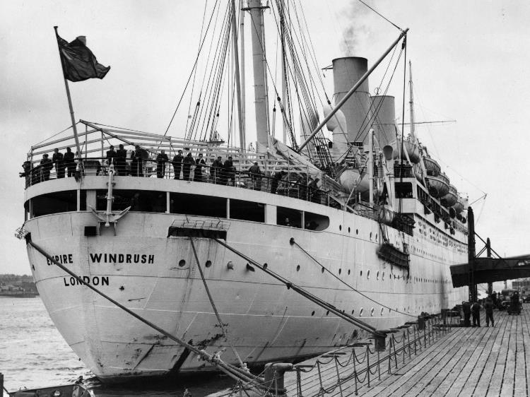
Windrush

Slide 3
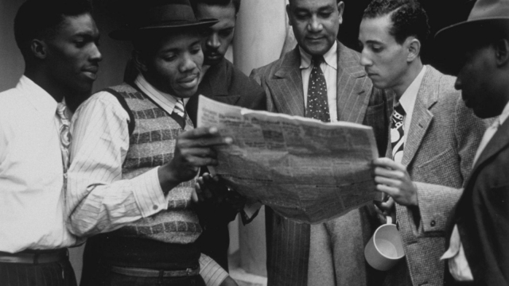

Notes:
There was a poster that invited people to come from Jamaica to England (find Jamaica on the inflatable globe, pass around a Jamaican flag, eat some guava)

Slide 4
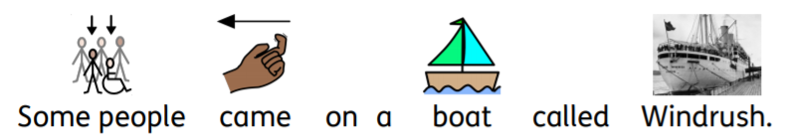
Notes:
Some people came on a boat called Windrush (pass around a model boat)

Slide 5
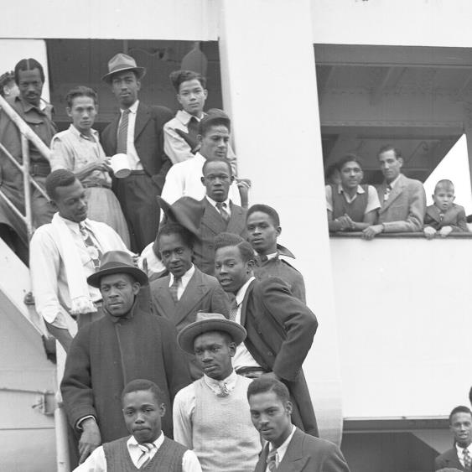

Notes:
The people arrived in England (find England on the globe, pass around an English flag, eat a piece of scone)

Slide 6
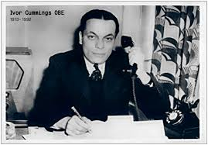
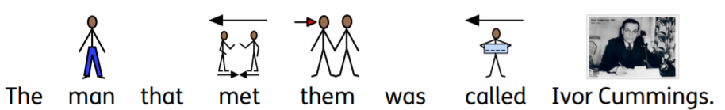
Notes:
The man that met them was a man called Ivor Cummings and it was his job to help the people (show the photo on the board, pass around a briefcase)

Slide 7
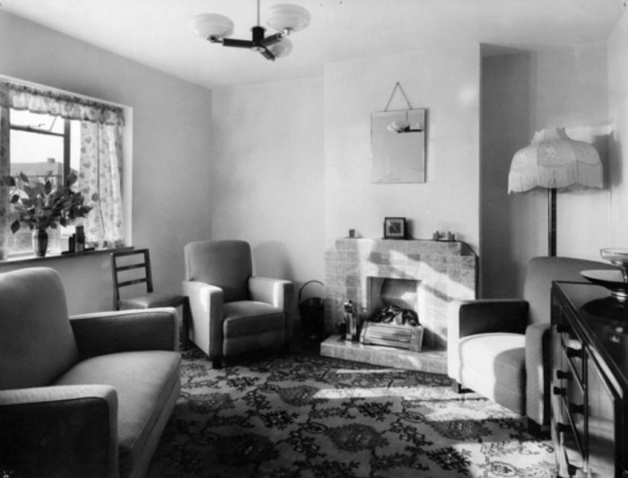
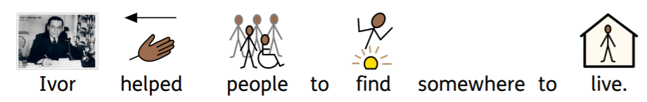
Notes:
Ivor helped the people to find somewhere to live (pass around the blanket)

Slide 8
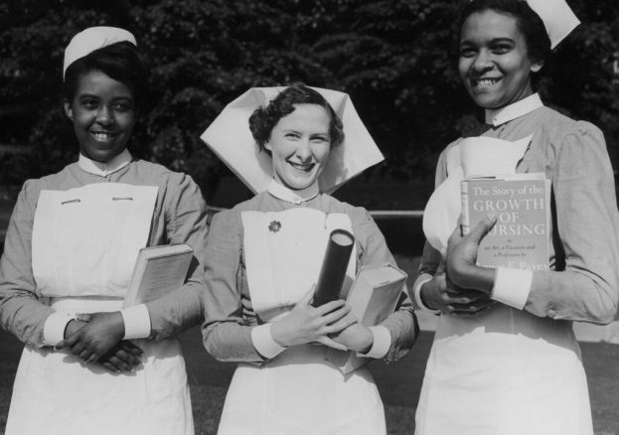
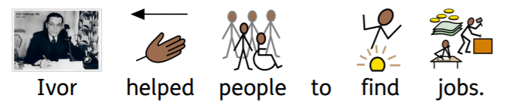
Notes:
Ivor helped people to find jobs (students try using the spanner to tighten the nut and bolt).

Slide 9

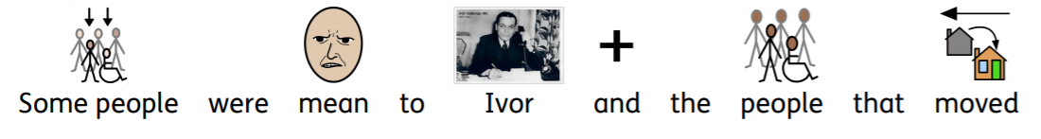
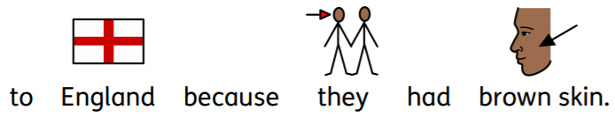
Notes:
Some people were mean to Ivor and the people that moved to England because they had brown skin. We should be kind to everyone.

Slide 10
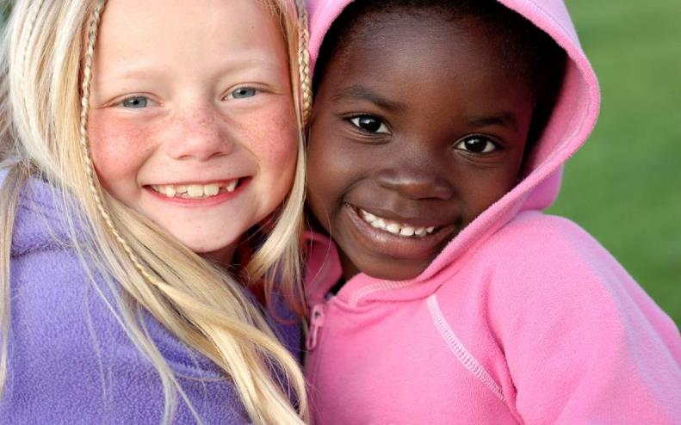
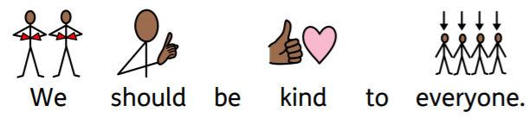
Notes:
We should be kind to everyone.

Slide 11
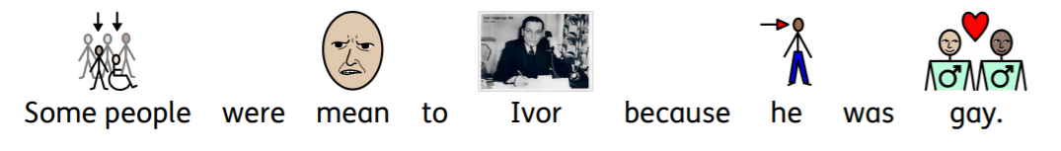
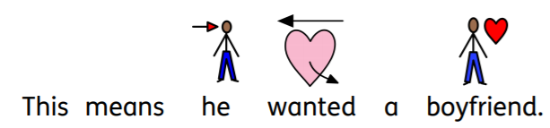
Notes:
Some people were mean to Ivor because he was gay (rainbow flag). This means he wanted a boyfriend. Some people are gay, it’s ok. We should be kind to people.

Slide 12
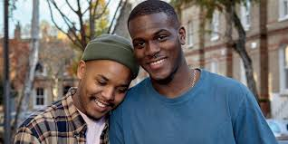
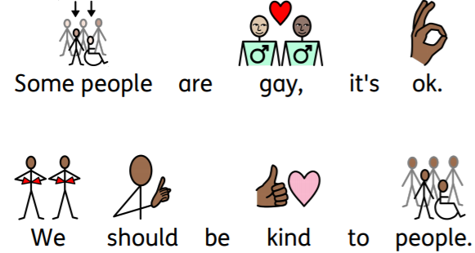
Notes:
Some people are gay, it’s ok. We should be kind to people.

Slide 13

Notes:
Students either create their own picture of Ivor Cummings welcoming the people off Windrush or use the line drawing to create a collage to represent the arrival of Windrush.
Extension:
Students label key aspects of their collage using some of the key words from the lesson
Students write a sentence about Ivor Cummings.

Slide 14
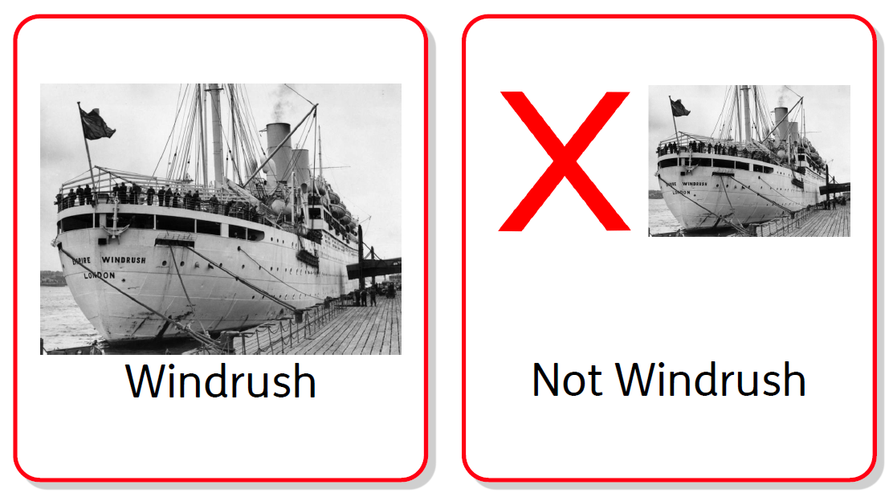
Notes:
As a class look at the photos and say if they were “Windrush” or “not Windrush”. Students hold up cards or whiteboards to show their answer.

Slide 15

Notes:
As a class look at the photos and say if they were “Windrush” or “not Windrush”. Students hold up cards or whiteboards to show their answer.

Slide 16
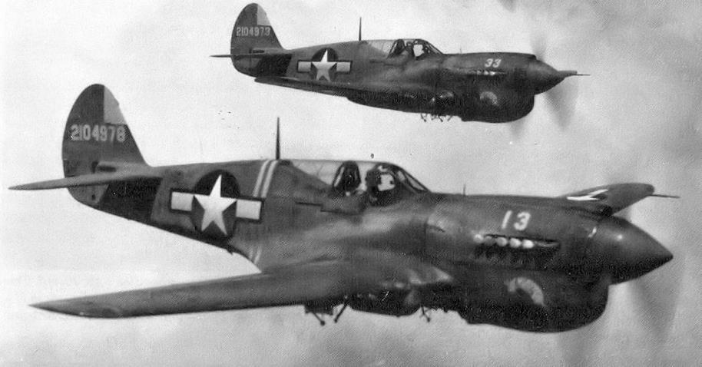
Notes:
As a class look at the photos and say if they were “Windrush” or “not Windrush”. Students hold up cards or whiteboards to show their answer.

Slide 17
Notes:
As a class look at the photos and say if they were “Windrush” or “not Windrush”. Students hold up cards or whiteboards to show their answer.

Slide 18
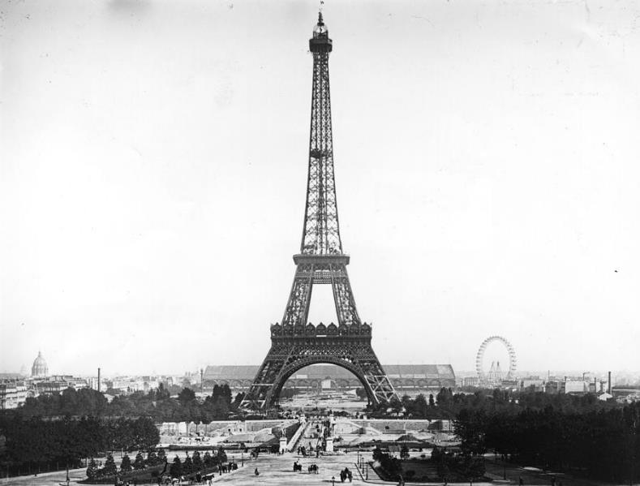
Notes:
As a class look at the photos and say if they were “Windrush” or “not Windrush”. Students hold up cards or whiteboards to show their answer.

Slide 19
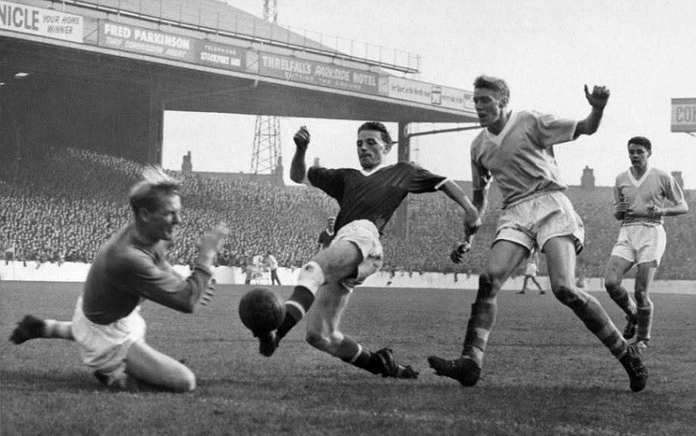
Notes:
As a class look at the photos and say if they were “Windrush” or “not Windrush”. Students hold up cards or whiteboards to show their answer.

Slide 20

Notes:
As a class look at the photos and say if they were “Windrush” or “not Windrush”. Students hold up cards or whiteboards to show their answer.

