Slide 1
PowerPoint template for the 2020 Anti-Bullying Week Assembly for:
Learners with SEND/ALN/ASN – version 2
We know that good teaching is tailored to meet the needs of the children or young people in each individual class. That’s why we’ve created this editable PowerPoint template – feel free to adapt it to suit your teaching context or to add your school or college slide template to the background.
Who are Stonewall?
This resource is produced by Stonewall, a UK-based charity that stands for the freedom, equity and potential of all lesbian, gay, bi, trans, queer, questioning and ace (LGBTQ+) people. At Stonewall, we imagine a world where LGBTQ+ people everywhere can live our lives to the full. Founded in London in 1989, we now work in each nation of the UK and have established partnerships across the globe. Over the last three decades, we have created transformative change in the lives of LGBTQ+ people in the UK, helping win equal rights around marriage, having children and inclusive education.
Our campaigns drive positive change for our communities, and our sustained change and empowerment programmes ensure that LGBTQ+ people can thrive throughout our lives. We make sure that the world hears and learns from our communities, and our work is grounded in evidence and expertise.
Stonewall is proud to provide information, support and guidance on LGBTQ+ inclusion; working towards a world where we’re all free to be. This does not constitute legal advice, and is not intended to be a substitute for legal counsel on any subject matter. To find out more about our work, visit us at www.stonewall.org.uk.
Registered Charity No 1101255 (England and Wales) and SC039681 (Scotland)
Notes:
Other versions of this assembly are available on Stonewall’s website: www.stonewall.org.uk

Slide 2
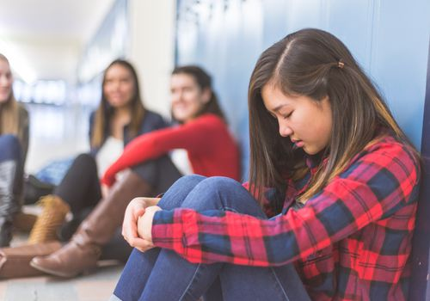
What is bullying?
Notes:
Ask students what they think bullying is

Slide 3
What is bullying?
Being unkind on purpose
Being unkind to the same person lots of times
Notes:
Explain that sometimes people are unkind to others because there is something about them that is different. If someone is mean to someone lots of times and on purpose, this is called bullying.

Slide 4
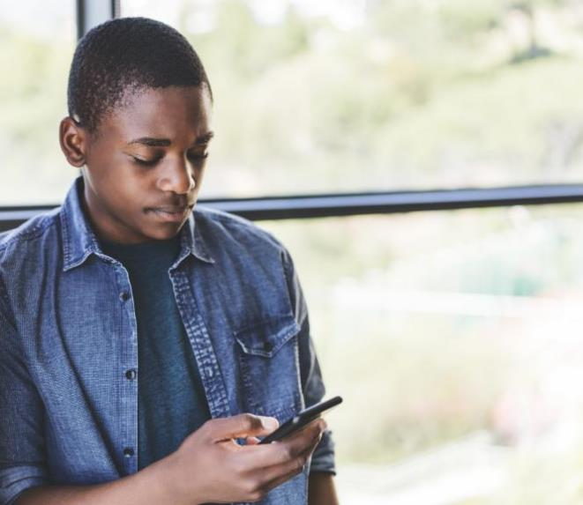
Sometimes people are bullied because of the colour of their skin.
This is called racism.
Notes:
Explain the concept of racism at an appropriate level.

Slide 5
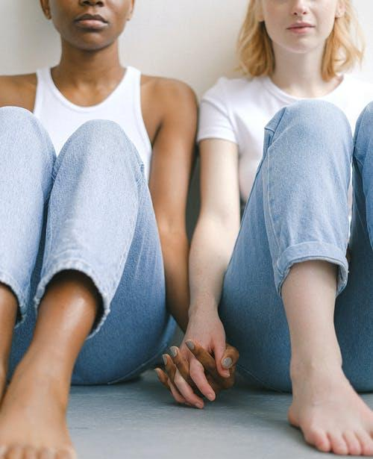
Sometimes people are bullied because they are lesbian, gay or bi.
This is called homophobia and biphobia.
Notes:
If needed, remind students what lesbian, gay and bi mean.

Slide 6
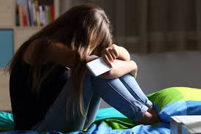
Sometimes people are bullied because of their gender.
Notes:
If needed explain that gender refers to whether someone is a boy, a girl or non-binary

Slide 7
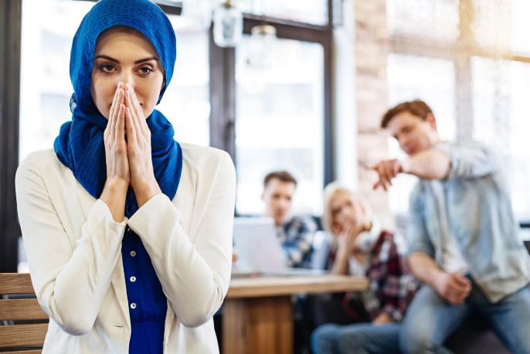
Sometimes people are bullied because of their religion.
Notes:
Explain that people have different religions and that’s ok

Slide 8
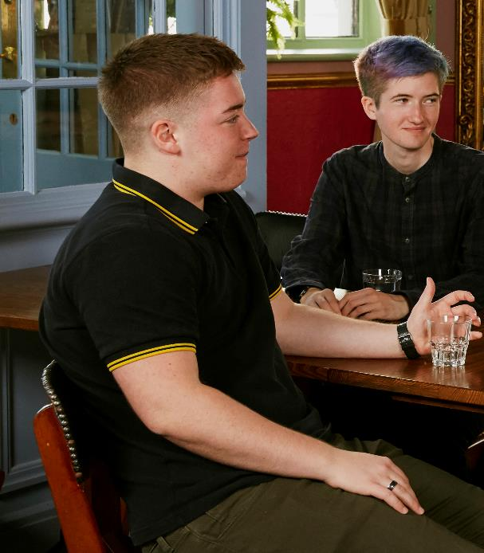
Sometimes people are bullied because they are trans.
Notes:
Explain that if someone is trans it means that:
For a trans boy, even through the doctors thought they were a girl when they were born, they grew up and said “I’m a boy”.
For a trans girl, even through the doctors thought they were a boy when they were born, they grew up and said “I’m a girl”.
For a non-binary person, the doctors would have either said “it’s a girl” or “it’s a boy” when they were born but actually they grew up and said “I’m not a boy and I’m not a girl, I’m non-binary”.

Slide 9
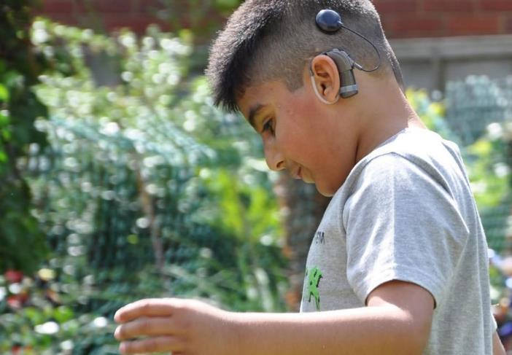
Sometimes people are bullied because they are disabled.
Notes:
Explain what disabled means

Slide 10
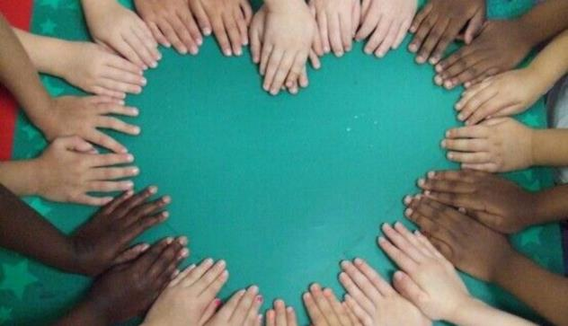
We are all different.
Being different is ok.
Bullying is not ok.
Notes:
Explain that we are all different and that it is ok to be different. Something that is not ok is bullying.

Slide 11

What can you do about bullying?
Be kind to people.
Notes:
Reiterate the importance of being kind to people and discuss what sort of thing is and isn’t kind

Slide 12
What can you do about bullying?
If someone is bullying you it is not OK.
Tell them to stop.
Tell an adult if you are being bullied.
Notes:
Reiterate what students should do if they are being bullied

Slide 13
What can you do about bullying?
If someone is being a bully, tell them to stop.
Tell an adult if someone is being bullied.
Notes:
Reiterate what students should do if they see that someone else is being bullied

