Slide 1
PowerPoint template for the 2020 Anti-Bullying Week Assembly for:
Secondary aged students
We know that good teaching is tailored to meet the needs of the children or young people in each individual class. That’s why we’ve created this editable PowerPoint template – feel free to adapt it to suit your teaching context or to add your school or college slide template to the background.
Who are Stonewall?
This resource is produced by Stonewall, a UK-based charity that stands for the freedom, equity and potential of all lesbian, gay, bi, trans, queer, questioning and ace (LGBTQ+) people. At Stonewall, we imagine a world where LGBTQ+ people everywhere can live our lives to the full. Founded in London in 1989, we now work in each nation of the UK and have established partnerships across the globe. Over the last three decades, we have created transformative change in the lives of LGBTQ+ people in the UK, helping win equal rights around marriage, having children and inclusive education.
Our campaigns drive positive change for our communities, and our sustained change and empowerment programmes ensure that LGBTQ+ people can thrive throughout our lives. We make sure that the world hears and learns from our communities, and our work is grounded in evidence and expertise.
Stonewall is proud to provide information, support and guidance on LGBTQ+ inclusion; working towards a world where we’re all free to be. This does not constitute legal advice, and is not intended to be a substitute for legal counsel on any subject matter. To find out more about our work, visit us at www.stonewall.org.uk.
Registered Charity No 1101255 (England and Wales) and SC039681 (Scotland)
Notes:
Other versions of this assembly are available on Stonewall’s website: www.stonewall.org.uk

Slide 2
Looking out for each other online
Notes:
Introduce the concept of anti-bullying week. Whilst we speak out against bullying all year round, anti-bullying week is a time for us all to reflect on our actions and to see if there is anything else we can be doing to combat bullying. This assembly contains some examples of online homophobic, biphobic and transphobic bullying – it is good practice to warn students ahead of time if they might find it upsetting.

Slide 3
Who uses social media?
Notes:
Ask students for a show of hands for the question: Who uses social media.
Ask: What platforms do you use? Is everything you see online pleasant?

Slide 4
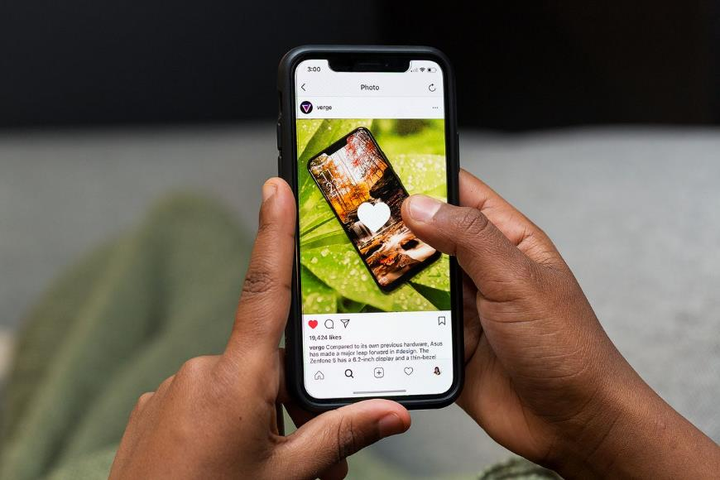
Is it ok?
Notes:
Explain that you’re about to look at some comments – students should identify which ones are acceptable, which ones are unacceptable.
(Note: it’s a trick question, they’re all unacceptable)

Slide 5
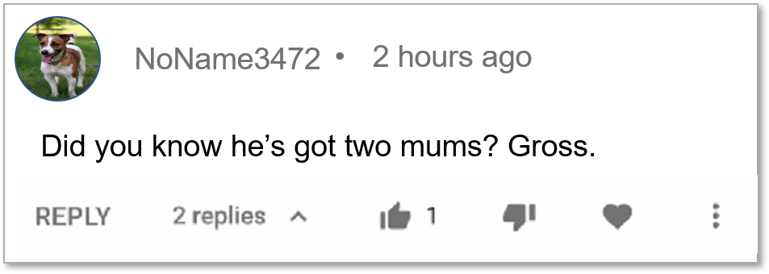
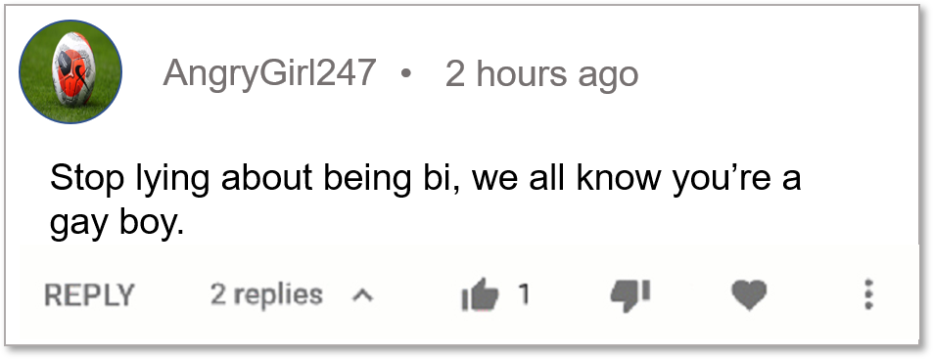
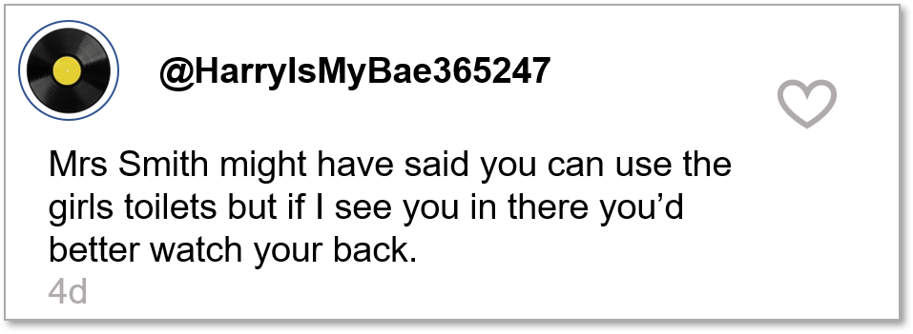
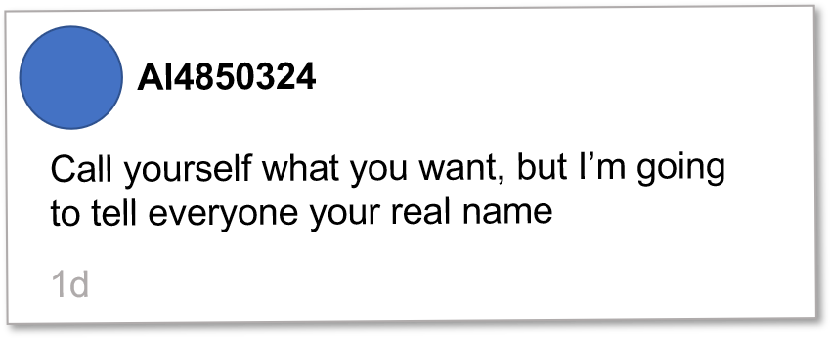
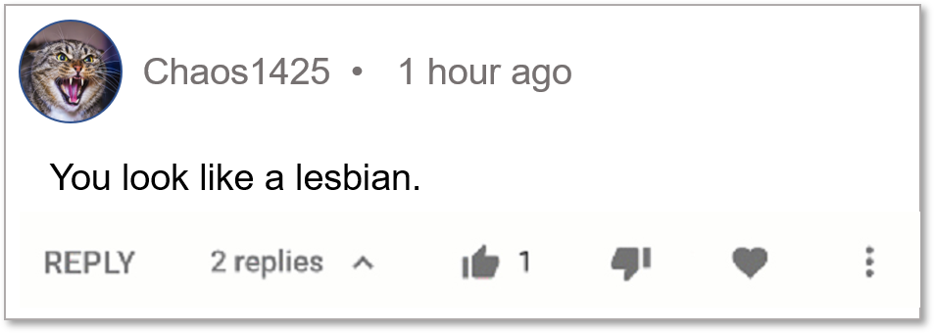
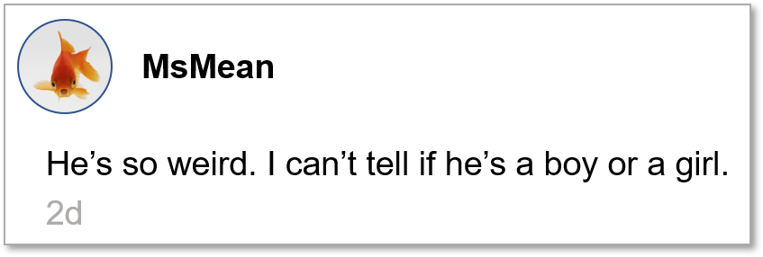
Notes:
Click to make each comment appear and then disappear. Ask students to identify if they’re acceptable or unacceptable.
(Note: it’s a trick question, they’re all unacceptable)

Slide 6
How might it feel?
Notes:
Discuss how it might feel for someone to receive or see a comment like that. What if they receive lots of comments like that?

Slide 7
What could you do?
Notes:
Discuss what someone could do if they saw comments like that. Take some suggestions from students.

Slide 8
What could you do?
Screenshot it
Report it
Call it out
Check in
Tell someone
Notes:
Discuss that students should:
Take a screenshot and note down the time and date – but don’t go sharing the screenshot around with others
Report homophobic, biphobic, or transphobic comments online using the report function on each platform, as well as any other discriminatory comments (such as racist comments, disablist comments)
Call out discrimination and prejudice when you see it – discuss how could they do this constructively and that they should only do this if they feel safe to. For example “Why are you saying ‘that’s so gay’ as if being gay is a bad thing?”.
Check in with the person on the receiving end to see if they’re ok and if there’s anything you can do to support them
If students see someone being bullied online, discuss how they can report it to a member of staff following the school anti-bullying policy

Slide 9
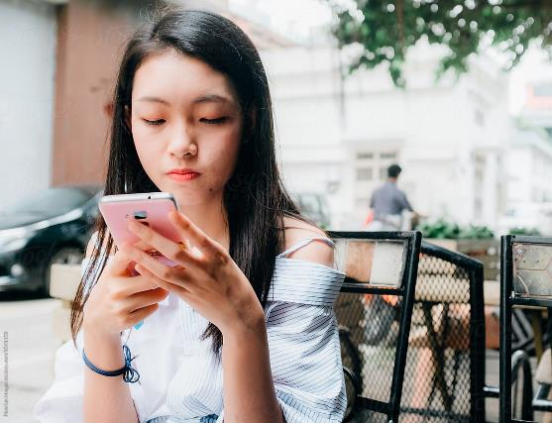
What if it’s you being bullied?
Notes:
Ask students what they should do if they’re being bullied or subject to discriminatory comments.

Slide 10
What if it’s you being bullied?
Screenshot it
Tell an adult
Report it
Notes:
Discuss that students should:
Take a screenshot and note down the time and date.
Tell an adult and talk to them about it.
Report homophobic, biphobic, or transphobic comments online using the report function on each platform, as well as any other discriminatory comments (such as racist comments, disablist comments)
Report the bullying in line with the school anti-bullying policy

Slide 11
Your commitment
Notes:
Ask students to make a commitment to unite against bullying by calling it out and reporting it wherever they see it and not being a bystander.

